Slide 1
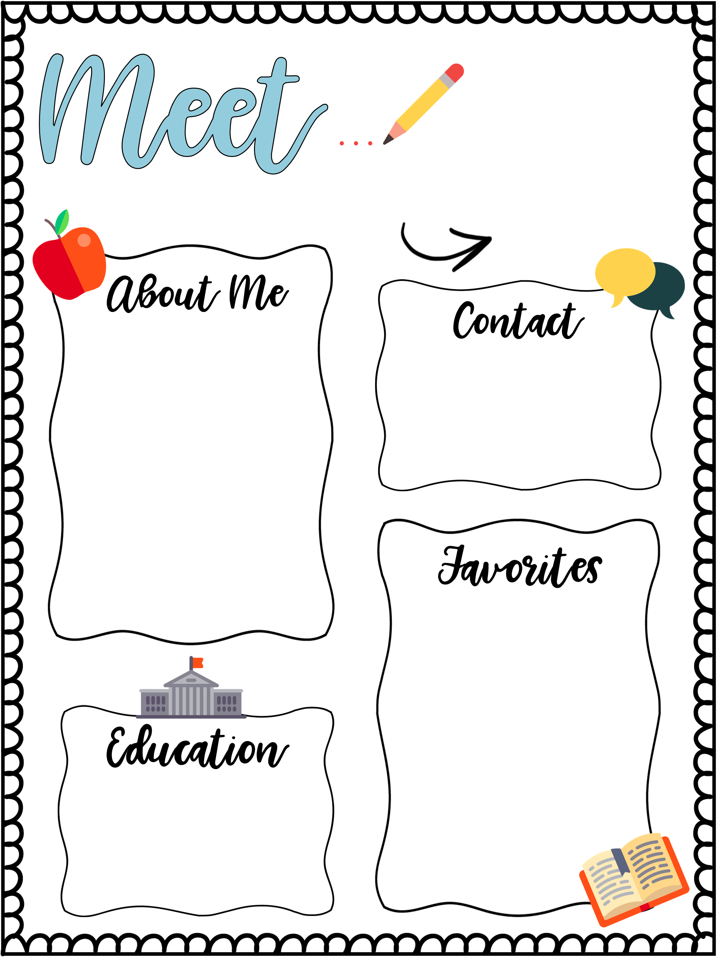
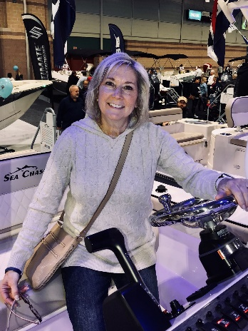
Mrs. Gulla
My name is Mrs. Gulla and I
am so excited to be teaching
at the Lillian Dunfee School and to be working with your children! I have been teaching preschool for
over 11 years and love it!
I am a mother of three and I
enjoy spending time with my
family, going to the beach
and playing with my dog,
Murphy. I can’t wait for this
year to begin. We have lots
of fun things planned.
Dgulla@barnegatschools.com
OR
REMIND
BOOK
Charlotte’s Web
PLACE
IRELAND
COLOR
BLUE
SPORT
FOOTBALL
FOOD
SCALLOPS
I am a graduate of Kutztown University and have a Bachelor of Science degree in Elementary Education. I have taught first grade, kindergarten and preschool.

